Slide 1
Mines, Minerals, and Minecraft
Dr. Charles “Chuck” Bell
Lesson 9: 03 April 2019

Slide 2
Agenda
Bible Study: 10-15 minutes
The Raspberry Pi: 5-10 minutes
Hacking Minecraft with Python: 30-45 minutes
Lab Time: Games in Minecraft

Slide 3
Bible Study
Caves in the Bible

Slide 4
Types of Caves
Natural
Hebrews 11:38 (Of whom the world was not worthy:) they wandered in deserts, and in mountains, and in dens and caves of the earth.
Artificial
Judges 6:2 And the hand of Midian prevailed against Israel: and because of the Midianites the children of Israel made them the dens which are in the mountains, and caves, and strong holds.

Slide 5
Where were they?
Open fields
Genesis 23:20 And the field, and the cave that is therein, were made sure unto Abraham for a possession of a burying place by the sons of Heth.
Rocks
Isaiah 2:19 And they shall go into the holes of the rocks, and into the caves of the earth, for fear of the LORD, and for the glory of his majesty, when he ariseth to shake terribly the earth.

Slide 6
Uses for Caves
Dwelling-places (Genesis 19:30)
Places of concealment (1 Samuel 13:6, 1 Samuel 14:11, 1 Kings 18:4, Hebrews 11:38)
Resting places (1 Samuel 24:3, 1 Kings 19:9)
Burial places (Genesis 23:19, John 11:38)
Haunts of robbers (Jeremiah 7:11, Matthew 21:13)
Hiding places of wild beasts (Nahum 2:12)
Store houses for goods
Jails (punishment)

Slide 7
Specific Caves in the Bible
Adullam
1 Samuel 22:1 David therefore departed thence, and escaped to the cave Adullam: and when his brethren and all his father's house heard it, they went down thither to him.
Engedi
1 Samuel 23:29-24 And David went up from thence, and dwelt in strong holds at Engedi. 1 And it came to pass, when Saul was returned from following the Philistines, that it was told him, saying, Behold, David is in the wilderness of Engedi.
1 Samuel 24:3 And he came to the sheepcotes by the way, where was a cave; and Saul went in to cover his feet: and David and his men remained in the sides of the cave.

Slide 8
Specific Caves in the Bible
Machpelah
Genesis 23:9 That he may give me the cave of Machpelah, which he hath, which is in the end of his field; for as much money as it is worth he shall give it me for a possession of a burying place amongst you.
Makkedah
John 10:16-17 And other sheep I have, which are not of this fold: them also I must bring, and they shall hear my voice; and there shall be one fold, and one shepherd. Therefore doth my Father love me, because I lay down my life, that I might take it again.

Slide 9
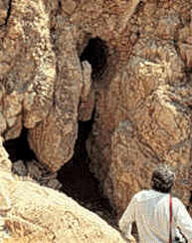
Found in caves: The Dead Sea Scrolls
In 1947 a Bedouin shepherd boy, searching for a lost goat, threw a stone into a cave opening in Qumran by the Dead Sea and heard the sound of shattering pottery. His inquisitiveness lead him to investigate and discover the first of what was to become known as the Dead Sea Scrolls. The world found out about them about one year later in 1948. The impact of this find on verifying the reliability of our Holy Scriptures cannot be overemphasized.

Slide 10
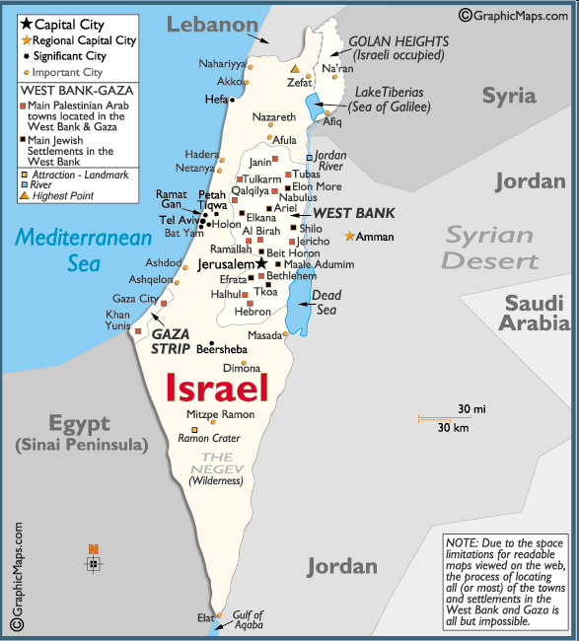
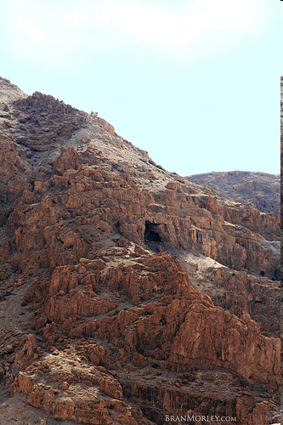

Where Is The Dead Sea?

Slide 11
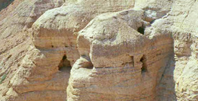
Dead Sea Scroll Facts
40,000 scroll fragments were found in jars in eleven different caves
35,000 scroll fragments from 400 manuscripts were found in Cave #4
All scrolls were produced prior to 67-73 AD (time of first Jewish-Roman war)
Literary remains of a Community that lived at Qumran from ~135 BC to ~67 AD
Scrolls contain samples of all OT books except Esther

Slide 12
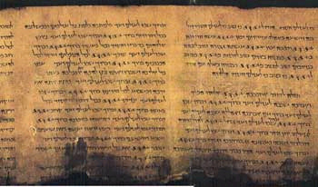
Dead Sea Scroll Facts - 2
Complete scroll of Isaiah (dated about 125 B.C.) was found in Cave #1
No NT book scrolls found (too early)
Large number of Jewish non-canonical writings
Largest scroll, the Temple Scroll, was 27 feet long
William F. Albright, the dean of American archaeology, called it “the greatest manuscript discovery of modern times.”

Slide 13
Results of Dead Sea Finds
Extant copies of books that are more than 1000 years older than the extant copies previously known to exist
Significantly increased our knowledge of what happened to the Hebrew text from 1000-800 BC, from which time we trace our present Hebrew Bible
Hebrew text has undergone much less change than previously thought
Hebrew Bible text is treated with greater respect by scholars today than it has been for a long time
Brought to light much knowledge about the Jewish sect of the Essenes

Slide 14
The Raspberry Pi
Build a Wildlife Cam!

Slide 15
Naturebytes Wildlife Camera Kit

Slide 16
Kit Contents

Slide 17
How does it work?

Slide 18
Assembly

Slide 19
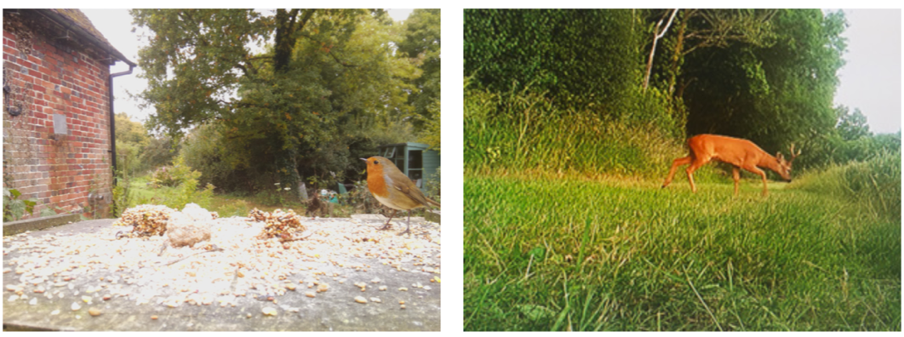
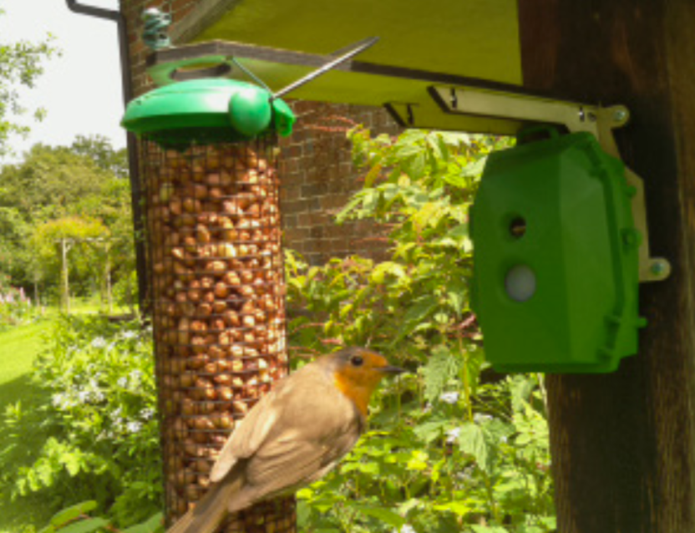

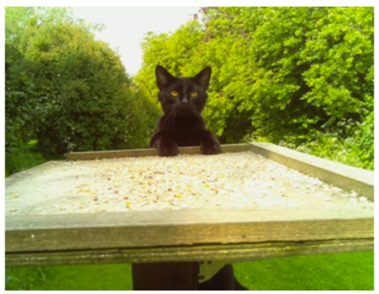
Example Photos

Slide 20
Hacking Minecraft with Python
Let’s build some (more) games!

Slide 21
More Python Games!
We will be having a competition next week using one or more of these games – so practice on them tonight!
There are 3 new games you can play.
Whac-a-Block
Hide and Seek
Big Cannon!

Slide 22
Whac-a-Block
The objective of the game is to whack (or hit with a sword) the blocks that light up as glowstone, and turn them back to stone.
You will earn points for each block you turn back to stone and the game is over when all the blocks have been turned into glowstone.
To run the game, you must first pull the latest changes (see previous slide).
Then, open the file named minecraft-whac.py and run it.

Slide 23
Whac-a-Block

Slide 24
Hide and Seek
The concept is really simple, a diamond block is hidden, at a random location, in the Minecraft world and you have to find it and stand next to it and its quickest time wins. You are helped along the way by the game telling you whether you are getting "warmer" or "colder" and how far you are from the block!

Slide 25
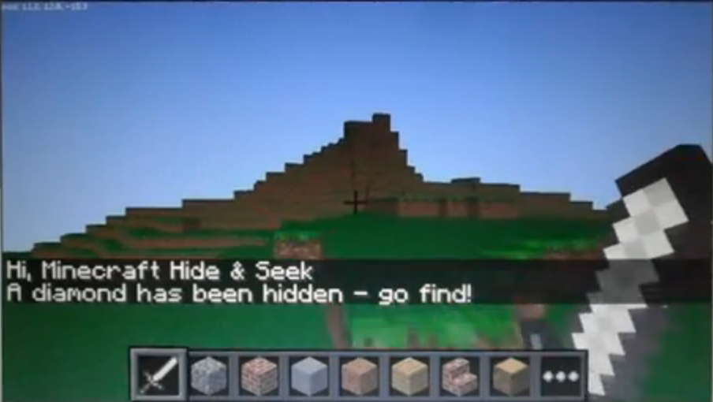
How to run Hide and Seek
Open a terminal, change to the source/minecraft-hs folder and run the commands:
cd minecraft-hs
export PYTHONPATH=$(pwd)
python minecraft-hs.py

Slide 26
Big Cannon!
This one is a lot of fun because you get to blow up stuff.
Can rapidly destroy your world.
It’s different because it uses a command line interface.
You can control the cannon you use the following commands:
start - create [start-up] the cannon
rotate [0-360 degrees] - rotate the cannon
tilt [0-90 degrees] - tilt the cannon upwards
fire - FIRE!
exit - exit and clear the cannon

Slide 27
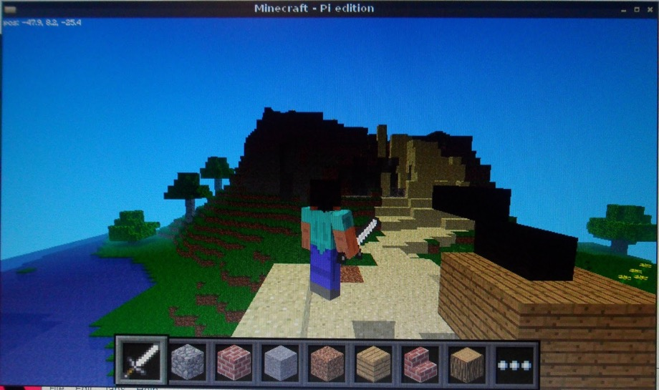
How to run Cannon
Open a terminal, change to the source/minecraft-cannon folder and run the command:
cd minecraft-cannon
export PYTHONPATH=$(pwd)
python minecraft-cannon.py

Slide 28
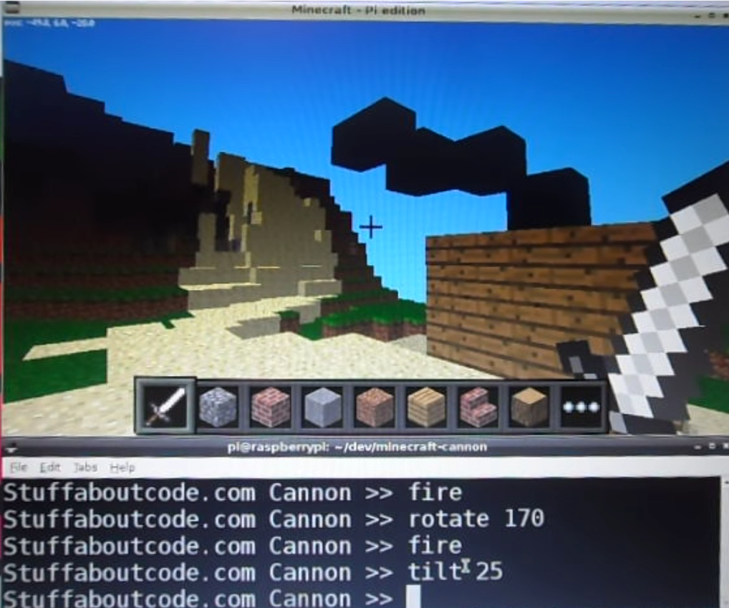
Big Cannon!
Tip: arrange the terminal so you can see it and the game.
Issue commands in the terminal.

Slide 29
LAB TIME
Use the remainder of class to explore new games.
You can leave when you’re finished.
DO NOT DISTURB the other classes!
REMEMBER TO SHUTDOWN YOUR RASPBERRY PI
DO NOT POWER IT OFF UNTIL YOU SHUTDOWN

Slide 30
Questions or comments?

